Slide 1
Road Accidents and Safety Analysis & Prediction
#11 Qifeng Zhou, Mengying Wang

Slide 2
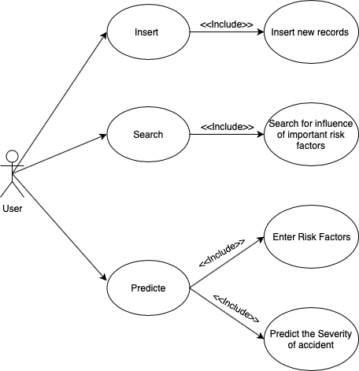
User Case

Slide 3
Methodology
Figure out the relationship between accident severity and some parameters such as: driver gender, driver age, rode type, etc. ———————-> How?: Spark MLlib
Digest real time data and show the graph. —> How? : Zepplin & Spark Streaming
Instance-based prediction of accident severity presence by the input data from user
Digest real time data & retrain the dataset to increase the accuracy of our prediction

Slide 4
Data sources
These files provide detailed road safety data about the circumstances of personal injury road accidents in GB from 1979, the types of vehicles involved and the consequential casualties. The statistics relate only to personal injury accidents on public roads that are reported to the police, and subsequently recorded, using the STATS19 accident reporting form. (https://data.gov.uk/dataset/cb7ae6f0-4be6-4935-9277-47e5ce24a11f/road-safety-data)
There are three tables in the datasets: Accident Circumstances, Vehicle and Vehicle, we will choose the useful information for us from them.

Slide 5
Milestones
Nov 11 -> Nov 14: Analyse and train the dataset, find out the most relevant variables.
Nov 15 -> Nov 22: Learn to use zepplin to generate the diagram.
Nov 23 -> Nov 30: Consult real time accident data and predict the possibility.
Nov 31 -> end: Implement the function which will digest the real time data and retrain the dataset to make the prediction more accurate.

Slide 6
About Project
Scala will be the main language in our project.
Probably we will use python on implementing some graph functions.
Code repository: https://github.com/MandyMY/Scala-Final-project

Slide 7
Acceptance criteria
Functional Criteria:
User can insert data, search for analysis result and predict base on new data.
Non-functional Criteria:
A simple interface will be provided to user.
Performance Criteria:
95% of queries to be performed in under 4 second.

Slide 8
Goals
Training the original database and the data entered by previous users (if they accept) by Machine Learning to predict the accident severity on one accident’s risk factors.
Trying to use the skill of Interpretable Machine learning to describe the influence of each risk factor by some plots, such as Partial Dependence Plot (PDP) and Individual Conditional Expectation (ICE), that will be a reference for users to learn how to prevent traffic accident.
Develop a simple interface for users.

